Slide 1
21.05.26
Solve problems involving addition and subtraction of mixed numbers
Efficient strategies for adding and subtracting mixed numbers (crossing a whole)

Slide 2
mixed number
improper fraction

Slide 3
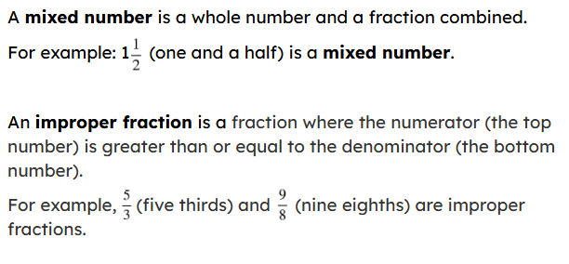

Slide 4
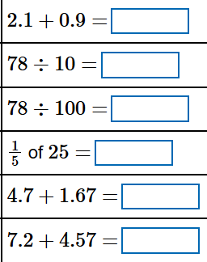
Starter

Slide 5

Solve problems involving addition and subtraction of mixed numbers
Interpreting data
Problem solving

Slide 6
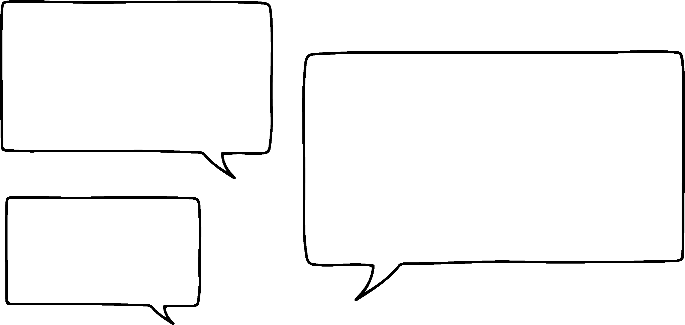
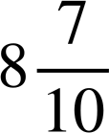
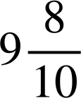

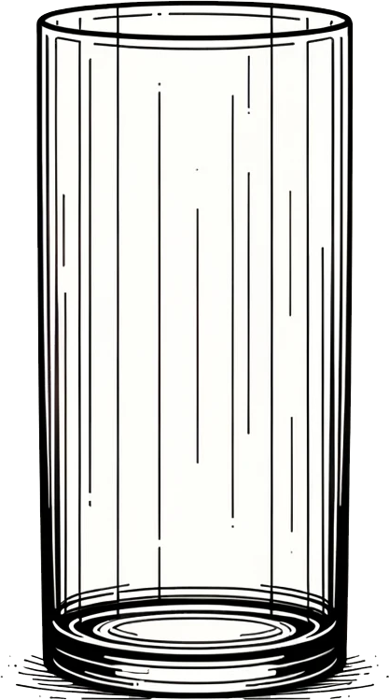
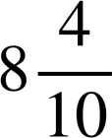
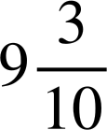
Interpreting data
Izzy records how much water she drinks each week for four weeks.
What questions could we ask about the data?
I notice that the units we are working with are litres and tenths.
Week | Water drunk (l)
1
2
3
4

Slide 7
Interpreting data
We could ask, ‘How much water does Izzy drink in total over the two weeks where she drinks the most?’
What do we need to do first?
Week | Water drunk (l)
1
2
3
4
We need to identify which weeks the question is asking about.

Slide 8
Interpreting data
Week | Water drunk (l)
1
2
3
4
We have two parts and the whole is the unknown total.
?
+
=

Slide 9



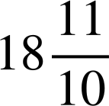
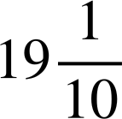
Interpreting data
9
9
18 +
=
=
What do you notice?
We need to do a final conversion because the fractional part of the mixed number is an improper fraction.

Slide 10


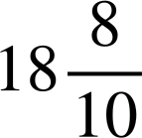
Interpreting data
It is always good practice to check calculations.
Let’s check this calculation using a number line instead of partitioning.
+ =
+ 9
+
+
19

Slide 11
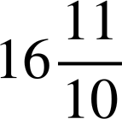
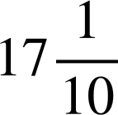
Interpreting data
How much water does Izzy drink over the two weeks where she drinks the least?
Week | Water drunk (L)
1
2
3
4
+ =
=
We can add by partitioning: first we add the whole number parts then we add the fractional parts.
A final conversion is needed.

Slide 12
Interpreting data
Another question we could ask is, ‘How much more water does Izzy drink in week four than week one?’
Week | Water drunk (L)
1
2
3
4
?
−
=

Slide 13

Interpreting data
− =
The numbers are close together, so we could use a number line and find the difference.
+
+
9

Slide 14


Interpreting data
It is always good practice to check calculations.
Let’s check this calculation by converting to improper fractions.
− =
− =
9 × 10 + 3 = 93
8 × 10 + 7 = 87

Slide 15
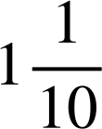
Interpreting data
How much more water does Izzy drink in week two than week one?
Week | Water drunk (l)
1
2
3
4
− =
The whole number part and fractional part are greater in the minuend, so we can use partitioning.

Slide 16




Interpreting data
1) Look at the data presented in this table about how many hours Izzy spends playing the guitar and answer the questions that follow.
a) How much longer does Izzy play for on Monday than Wednesday?
Day | Hours
Monday
Tuesday
Wednesday
Thursday
b) How many hours does Izzy play in total over Wednesday and Thursday?
c) What is the difference in time between the day that Izzy spends the longest and shortest time playing?

Slide 17



Interpreting data
1) Look at the data presented in this table about how many hours Izzy spends playing the guitar and answer the questions that follow.
a) How much longer does Izzy play for on Monday than Wednesday?
Day | Hours
Monday
Tuesday
Wednesday
Thursday
− =
The numbers are close. We can find the difference by counting on.
Izzy plays for three-quarters of an hour longer on Monday.
+
+
4

Slide 18


Interpreting data
b) How many hours does Izzy play in total over Wednesday and Thursday?
Day | Hours
Monday
Tuesday
Wednesday
Thursday
+ =
=
We can add by partitioning. First add the whole numbers then add the fractional parts and recombine.
A final conversion is needed.
Izzy plays for five and one-quarter hours in total over Wednesday and Thursday.

Slide 19




Interpreting data
The difference in time that Izzy spends playing is two and two-quarter hours.
c) What is the difference in time between the day that Izzy spends the longest and shortest time playing?
Day | Hours
Monday
Tuesday
Wednesday
Thursday
− =
− =
=
We can convert to improper fractions. First multiply the whole number by the denominator then add the numerator.
The denominators are the same, so subtract the numerators.
A final conversion is needed.

Slide 20
Solve problems involving addition and subtraction of mixed numbers
Interpreting data
Problem solving

Slide 21


Problem solving
Andeep’s school day is six and one-quarter hours long.
One and three-quarter hours are spent at break.
How many hours of learning are there in his school day?
How would you start to answer this?

Slide 22

Problem solving
Andeep’s school day is six and one-quarter hours long.
One and three-quarter hours are spent at break.
How many hours of learning are there in his school day?
Let’s start by representing this as a bar model.
−
=
?

Slide 23

Problem solving
?
−
=
−
−
− 1
5

Slide 24

Problem solving
Andeep’s school day is six and one-quarter hours long.
Andeep stays after school for science club for another one and three-quarter hours on Tuesday.
How long is Andeep at school for on Tuesday?
?
+
=
= 8

Slide 25




Problem solving
Which bar model represents this problem?
This is a comparison problem, so we have one whole and a part.
Izzy eats three and two-sevenths of pizza. How much more pizza does she eat than Andeep who has eaten two and six-sevenths of pizza?
a
 | ?
c
?
b
 | ?
d
?

Slide 26
Problem solving
1) Represent these problems in a bar model then solve.
a) A tailor has three and seven-tenth metres of ribbon. She uses one and nine-tenths to complete a dress. How much ribbon is left?
b) At the beginning of break, there are 15 oranges. After break there are three and two-sixth oranges left. How many oranges were eaten?
c) Andeep did a sponsored walk for charity. He walked six and four-fifth kilometres one day and three and three-fifth kilometres the next day. How far did he walk in all?

Slide 27
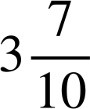
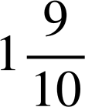
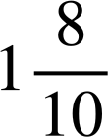



Problem solving
1) Represent these problems in a bar model then solve.
a) A tailor has three and seven-tenth metres of ribbon. She uses one and nine-tenths to complete a dress. How much ribbon is left?
We cannot use partitioning but we could count back because the subtrahend is small, find the difference by counting on because the numbers are not too far apart or convert to improper fractions.
− =
− =
=
There is one and eight-tenth metres of ribbon left.

Slide 28

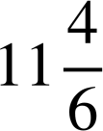

Problem solving
b) At the beginning of break, there are 15 oranges. After break there are three and two-sixth oranges left. How many oranges were eaten?
You might have chosen to count back to solve this equation. Whichever method you used, should give the same answer.
15
15 − =
−
− 3
11 and four-sixth oranges were eaten.
12
15

Slide 29
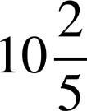



Problem solving
c) Andeep did a sponsored walk for charity. He walked six and four-fifth kilometres one day and three and three-fifth kilometres the next day. How far did he walk in all?
You might have chosen to use partitioning as a strategy to solve the equation: first add the whole parts, then add the fractional parts, then recombine.
+ =
=
A final conversion is then required.
Andeep walked 10 and two-fifth kilometres in all.

Slide 30
Solve problems involving addition and subtraction of mixed numbers
When interpreting data or solving problems, number-sense is needed to determine the most efficient strategy to use when adding or subtracting mixed numbers.
Bar models are a useful tool to represent word problems and support in forming an equation to solve.

