Slide 1
Round a 4-digit number to the nearest thousand, hundred and ten
Comparing, ordering and rounding 4-digit numbers

Slide 2
How our teaching resources are designed for the classroom

Slide 3
I can round a 4-digit number to the nearest thousand, hundred and ten.

Slide 4
rounding

Slide 5
Rounding means making a number simpler but keeping its value close to what it was. For example, to the nearest hundred, 623 rounds to 600

Slide 6

Round a 4-digit number to the nearest thousand, hundred and ten
Rounding a 4-digit number in different ways
Problem solving with rounding

Slide 7
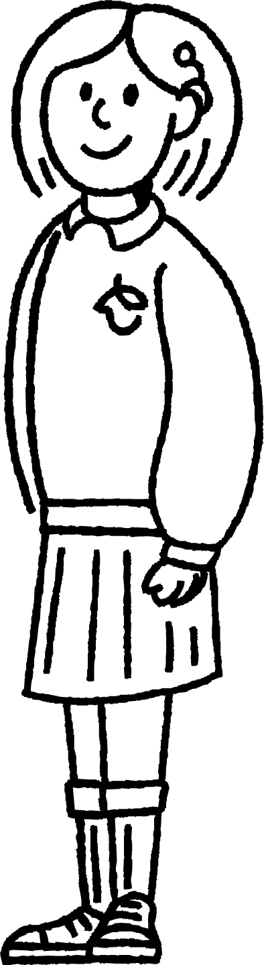
Rounding a 4-digit number in different ways
In this lesson, you will meet:
Sofia

Slide 8
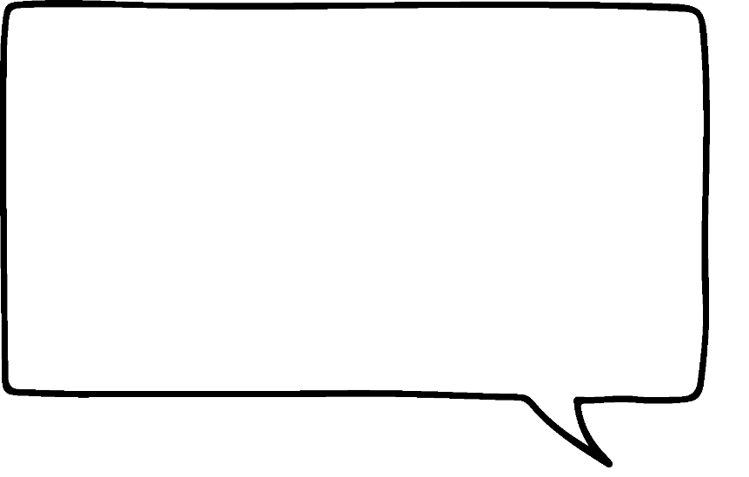

Rounding a 4-digit number in different ways
Sofia is rounding 4,735 in different ways by sketching number lines.
To the nearest hundred.
To the nearest thousand.
To the nearest ten.
4,000
4,700
5,000
4,800
4,740
4,730
The answer will be a multiple of 1,000 so it will end in at least three zeros.
It is in between 4,000 and 5,000
The 7 hundreds tells me it is closer to 5,000
4,735 rounded to the nearest multiple of 1,000 is 5,000
The answer will be a multiple of 100 so it will end in at least two zeros.
It is in between 4,700 and 4,800
The 3 tens tells me it is closer to 4,700
4,735 rounded to the nearest multiple of 100 is 4,700
The answer will be a multiple of 10 so it will end in at least one zero.
It is in between 4,730 and 4,740
It has 5 ones so I need to apply a rule.
4,735 rounded to the nearest multiple of 10 is 4,740

Slide 9
Rounding a 4-digit number in different ways
Sofia is rounding 7,995 What do you notice?
To the nearest thousand.
7,000
8,000
To the nearest hundred.
7,900
8,000
To the nearest ten.
7,990
8,000

Slide 10


Rounding a 4-digit number in different ways
Which of these numbers could be the result of rounding a whole number to the nearest 100?
Any number from 4,950 to 5,049 rounds to 5,000
Any number from 5,150 to 5,249 rounds to 5,200
This number is not a multiple of 100
This number is not a multiple of 100
5,000
5,200
5,280
5,309

Slide 11
Rounding a 4-digit number in different ways
Round this 4-digit number to the nearest 1,000, 100 and 10
 | Nearest 1,000 | Nearest 100 | Nearest 10
2,507
3,000
2,500
2,510

Slide 12
Rounding a 4-digit number in different ways
1) Draw lines to round 7,852 in different ways:
To the nearest 1,000
7,850
To the nearest 100
8,000
To the nearest 10
7,900
2) Give Sofia some feedback.
6,352 rounded to the nearest 100 is 6,452

Slide 13
Rounding a 4-digit number in different ways
3) Round these 4-digit numbers to the nearest 1,000, 100 and 10:
 | Nearest 1,000 | Nearest 100 | Nearest 10
3,768
6,591
8,808
5,555
2,004
4) List some numbers which round to 3,000 to the nearest 100 and 3,000 to the nearest 1,000

Slide 14
Rounding a 4-digit number in different ways
1) Draw lines to round 7,852 in different ways:
To the nearest 1,000
7,850
To the nearest 100
8,000
To the nearest 10
7,900
Sofia has remembered that the 5 tens means the number rounds to the next multiple of 100
However, her answer is not a multiple of 100
The correct answer is 6,400
2) Give Sofia some feedback.
6,352 rounded to the nearest 100 is 6,452

Slide 15
Rounding a 4-digit number in different ways
3) Round these 4-digit numbers in different ways:
 | Nearest 1,000 | Nearest 100 | Nearest 10
3,768
6,591
8,808
5,555
2,004
4,000
3,800
3,770
7,000
6,600
6,590
9,000
8,800
8,810
6,000
5,600
5,560
2,000
2,000
2,000
4) List some numbers which round to 3,000 to the nearest 100 and 3,000 to the nearest 1,000
Any numbers from 2,950 to 3,049

Slide 16
Round a 4-digit number to the nearest thousand, hundred and ten
Rounding a 4-digit number in different ways
Problem solving with rounding

Slide 17
Problem solving with rounding
The difference between two 4-digit numbers is 5
When each number is rounded to the nearest 1,000, the difference between them is 1,000
What could the two numbers be?
1,495
1,000
2,000
1,500
A systematic approach will help to find all of the possibilities.
Start with the possibilities where the thousands digit is 1
Notes:
The rounded numbers have a difference of 1,000
1,500 rounds to 2,000
The lowest number that will round to the next multiple of 1,000 is 1,500
1,495 rounds to 1,000
The numbers being rounded have a difference of 5
5 less than 1,500 is 1,495

Slide 18
Problem solving with rounding
Keep increasing the numbers by one until the statement is no longer true.
1,496
1,000
2,000
1,501
1,497
1,000
2,000
1,502
1,498
1,000
2,000
1,503
1,499
1,000
2,000
1,504

Slide 19
Problem solving with rounding
The difference between two 4-digit numbers is 5
When each number is rounded to the nearest 1,000, the difference between them is 1,000
What could the two numbers be?
2,495
2,000
3,000
2,500
The same possibilities can be explored with numbers where the thousands digit is 2

Slide 20
Problem solving with rounding
The difference between two 4-digit numbers is 5
When each number is rounded to the nearest 1,000, the difference between them is 1,000
What could the two numbers be?
The possibilities where the thousands digit is 2 are:
2,495↔2,500
2,496↔2,501
2,497↔2,502
2,498↔2,503
2,499↔2,504

Slide 21
Problem solving with rounding
The difference between two 4-digit numbers is 5
When each number is rounded to the nearest 1,000, the difference between them is 1,000
What could the two numbers be?
Which possibilities exist where the thousands digit is 3?
3,495↔3,500
This could be repeated for the thousands digit of 4, 5, 6, 7, 8 and 9
3,496↔3,501
There are five possibilities each time.
3,497↔3,502
3,498↔3,503
That makes 45 possible answers to the question!
3,499↔3,504

Slide 22
Problem solving with rounding
1) Use rounding skills to answer the following question. Think about which digit you need to consider each time.
a) There is 1,750 ml of juice in a jug. What is this rounded to the nearest litre?
b) The mass of Sofia’s labrador is 3,207 g. What is this to the nearest 1 kg?
c) In a year, Oak Academy raises £2,457 for charity. Class 6 raise an additional £128 from a cake sale.
Rounded to the nearest £10, how much has been made for charity?

Slide 23
Problem solving with rounding
2) The difference between two 4-digit numbers is 3
When each number is rounded to the nearest 10, the difference between them is 10
The numbers have a thousands digit of 3 and a hundreds digit of 4
What could the two numbers be? Give as many possible answers as you can.

Slide 24
Problem solving with rounding
3) Using each digit card only once, how many different ways can you fill the boxes? Can you be systematic and find all of the possibilities?
0
1
2
3
4
5
6
7
A number that rounds to 1,400 to the nearest 100
A number that rounds to 4,000 to the nearest 1,000

Slide 25
Problem solving with rounding
1) Use rounding skills to answer the following question. Think about which digit you need to consider each time.
a) There is 1,750 ml of juice in a jug. What is this to the nearest litre?
b) The mass of Sofia’s labrador is 3,207 g. What is this to the nearest 1 kg?
The 7 hundreds tells you that this is closer to 2,000 ml than it is to 1,000 ml, so it rounds to 2 litres.
3,207 is between 3,000 and 4,000 which is 3 kg and 4 kg. 3,207 is closer to 3,000 so it is 3 kg to the nearest 1 kg.

Slide 26
Problem solving with rounding
c) In a year, Oak Academy raises £2,457 for charity. Class 6 raise an additional £128 from a cake sale.
Rounded to the nearest £10, how much has been made for charity?
£2,457 + £128 = £2,585 so Oak Academy have raised £2,585
This is £2,590 to the nearest £10

Slide 27
Problem solving with rounding
2) The difference between two 4-digit numbers is 3
When each number is rounded to the nearest 10, the difference between them is 10
The numbers have a thousands digit of 3 and a hundreds digit of 4
What could the two numbers be? Give as many possible answers as you can.
Using a systematic approach, the first possibility is as follows:
3,400
3,410
3,402
3,405

Slide 28
Problem solving with rounding
The full range of possible answers are:
3,402↔3,405
3,432↔3,435
3,462↔3,465
3,403↔3,406
3,433↔3,436
3,463↔3,466
3,404↔3,407
3,434↔3,437
3,464↔3,467
3,412↔3,415
3,442↔3,445
3,472↔3,475
3,492↔3,495
3,413↔3,416
3,443↔3,446
3,473↔3,476
3,493↔3,496
3,414↔3,417
3,444↔3,447
3,474↔3,477
3,494↔3,497
3,422↔3,425
3,452↔3,455
3,482↔3,485
3,423↔3,426
3,453↔3,456
3,483↔3,486
3,424↔3,427
3,454↔3,457
3,484↔3,487

Slide 29
Problem solving with rounding
3)
0
1
2
3
4
5
6
7
A number that rounds to 1,400 to the nearest 100
A number that rounds to 4,000 to the nearest 1,000
As long as no card can be used more than once, the top number can be anything from 1,350 to 1,437 and the bottom number anything from 3,502 to 4,376

Slide 30
Round a 4-digit number to the nearest thousand, hundred and ten
Any 4-digit whole number can be rounded to the nearest 1,000 / 100 / 10
It may be helpful to sketch a quick number line to help with the rounding, although you may be able to visualise the number line or apply rules about rounding numbers.
These skills can be applied to problem solving scenarios about rounding numbers.

Slide 31

© Oak National Academy 2024.
Produced in partnership with Mathematics in Education and Industry.
Licensed on the Open Government Licence v3.0, except where otherwise stated. See Oak terms and conditions.

