Slide 1
13.03.26
Translation
Coordinates

Slide 2
13.03.26
Describe translations of polygons drawn on a square grid
Coordinates

Slide 3
Starter
6724 – 2470
6349 – 8934
7830 – 839
7835 – 3498
9384 – 348

Slide 4
translate / translating
translation

Slide 5
Translation is a transformation in which every point of a shape moves the same distance in the same direction.
The act of moving is to translate.

Slide 6

Describe translations of polygons drawn on a square grid
Describe and mark all points
Translate one point

Slide 7
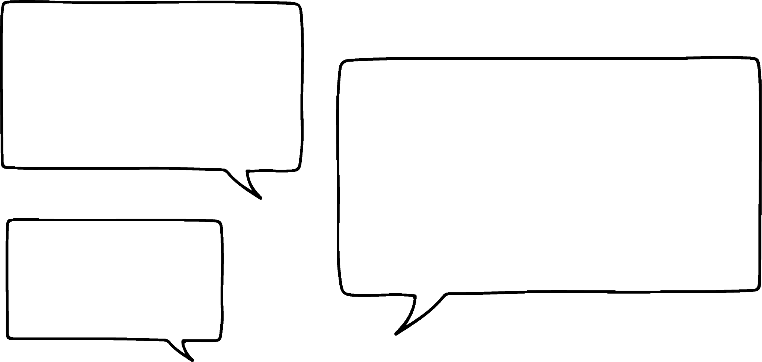



Describe and mark all points
Jacob and Sofia are exploring the movement of a polygon on a grid.
 |  | 1 | 2 | 3 | 4
Think of it like sliding a toy car on a table. You can move the car to the left, right, up, or down, but the car itself doesn't change. It just moves to a new spot.
A
B
When we move a shape from one place to another on a grid without changing its size or turning it, we are translating the shape.
A

Slide 8
Describe and mark all points
Sofia and Jacob are playing a game. They have to get the polygon from A to B.
A
A
A
A
Count 4 squares straight up from the starting point.
B
A
Now, count 3 squares right from the new position.
A
A
A
The polygon has been translated 4 squares up and 3 squares to the right.

Slide 9
Describe and mark all points
Jacob finds another way to translate from A to B
A
Count 3 squares to the right.
B
A
A
Now, count 4 squares up from the new position.
A
A
A
A
A
The polygon has been translated 3 squares to the right and 4 squares up.

Slide 10
Describe and mark all points
Jacob and Sofia now translate from A to B.
Jacob’s translation
Sofia’s translation
The polygon has been translated 4 squares down and 3 squares to the right.
A
A
A
A
The polygon has been translated 3 squares to the right and 4 squares down.
A
A
A
A
A
A
B
A
A
A
B
What do you notice about Sofia and Jacob’s translations?
Notes:
They both end up at the same final position. The order of the instructions doesn't change the final position.

Slide 11
Describe and mark all points
Sofia and Jacob now move onto playing a game to test each other’s knowledge.
Jacob gives Sofia directions for her to translate her polygon.
2 squares right and 2 squares down. What’s the new position?
A
To make sure I am accurate, I’ll mark a dot on one vertex of my polygon. Then I’ll translate the red dot.
B
By marking the vertices and following these steps, you can confidently find the new position of the shape after translation.

Slide 12

Describe and mark all points
Marking the vertex of a shape helps make sure you translate the shape correctly on a grid.
True. Marking the vertex of a shape gives you a clear point to count from when you move it. This helps you translate the shape the right number of squares in the right direction, so it ends up in the correct new spot. It also makes sure the whole shape stays the same size and looks the same after translation.

Slide 13
Describe and mark all points
Jacob and Sofia move onto another round.
3 squares right and 2 square up. What’s the new position?
B
A
Remember to move the correct number of squares in the given directions.

Slide 14


Describe and mark all points
Look at Sofia’s directions below, which image shows the correct translation?
2 squares right and 2 square up. What’s the new position?
B
A
B
A
a
b
B is correct, each vertex has been translated by 2 squares right and 2 squares up.

Slide 15
Describe and mark all points
1) Translate the shapes by marking each vertex.
a) Shape A is translated 3 right and 2 down
b) Shape B is translated 6 left and 1 up
c) Shape C is translated 4 squares left and 1 square down
d) Shape D is translated 5 squares right and 1 square up.
C
A
B
D

Slide 16
Describe and mark all points
2) Do you agree with Sofia?
Explain your thinking.
The order of translation steps does not affect the final position of the shape.

Slide 17
Describe translations of polygons drawn on a square grid
Describe and mark all points
Translate one point

Slide 18
Translate one point
If you move one vertex correctly, you can use that information to move the other corners in the same way.
 |  | 1 | 2 | 3 | 4
For example, if you move one vertex 4 squares to the right you can move all the other vertices the same amount.
A
This keeps the shape the same size and makes it quicker and easier to translate the whole shape.
B

Slide 19
Translate one point
They look at another example.
 |  | 4 | 3 | 2 | 1
B
A
Decide the direction in which you need to move the polygon. Directions can be right, left, up, or down.
A
I need to move 4 squares to the left.
Marking the vertex will help you to move the shape.
What advice might you give to Jacob to do this?

Slide 20
Translate one point
Jacob and Sofia now want to translate polygon A 4 right and 3 down.
 |  | 1 | 2 | 3 | 4 | 1
 |  |  |  |  |  | 2
 |  |  |  |  |  | 3
A
Think carefully about the direction you need to move it. Count carefully.
What advice might you give to Jacob to do this?

Slide 21
Translate one point
Jacob and Sofia now want to translate polygon A to B
Now, I just need to draw the shape so it’s the same size as before.
A
The sides are two square units long. It’s a square so the vertices need to be right angles.
B
A
This strategy can be more efficient for more simple polygons.

Slide 22

Translate one point
Which translation is correct to describe A to B?
B is correct.
B
The polygon has been translated 5 squares to the left and 2 squares up.
The polygon has been translated 4 squares to the left and 1 square up.
A
a
b

Slide 23
Translate one point
1) Translate the shapes following the directions. For each:
- Mark and translate one vertex.
- Use the polygon properties to re-draw the shape.
a)
b)
A
B
4 squares to the right and 2 squares down.
4 squares to the left and 2 squares down.

Slide 24
Translate one point
c)
d)
D
C
3 squares to the left and 2 squares up.
3 squares to the left and 2 squares up.

Slide 25
Translate one point
2) What advice would you give to Jacob?
Explain your thinking.
If you move one vertex of a shape 4 squares to the right and 3 squares up, how should you move the other vertices to keep the shape the same?

Slide 26
Describe translations of polygons drawn on a square grid
We understand that if a shape has moved you say it has been translated.
We understand that if a shape has moved, you can describe the move using left, right, up, down and the number of squares moved.
We understand that a shape can be translated in a vertical and horizontal direction.

